Slide 1
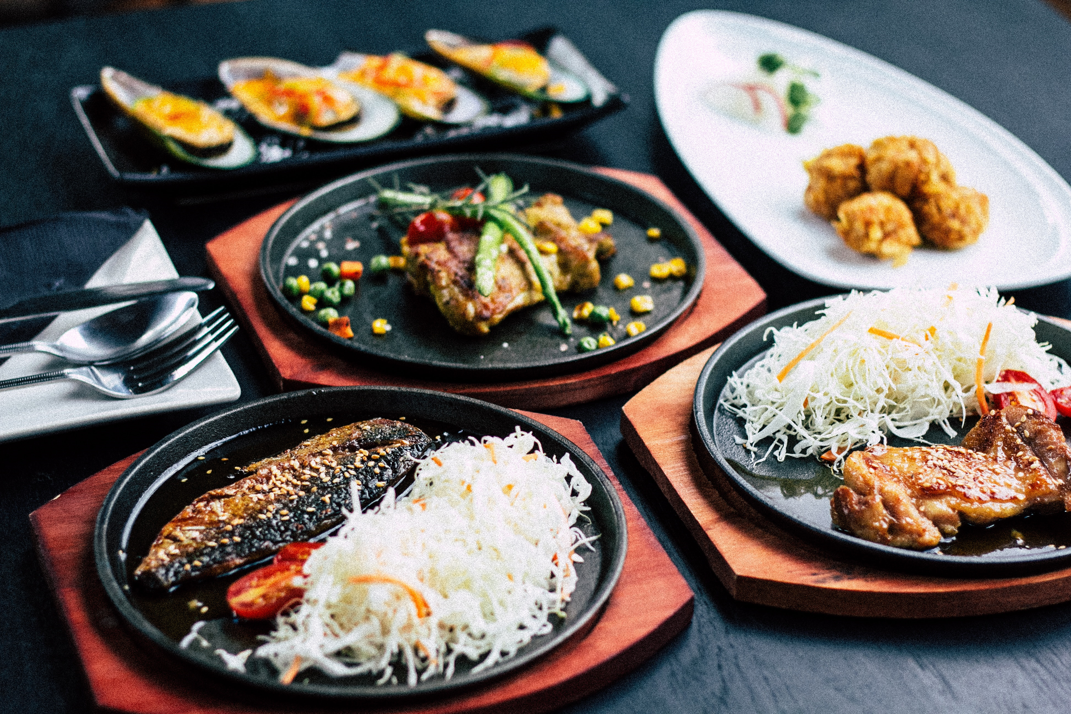

Recommendation System
Big Data –Fall Quarter 2019
Carrie Lu | Daniela Matinho | Hanna Kerr | Yuling Gu

Slide 2

Agenda
Yelp company
Business Problem
Data: Exploratory analysis
Data: Sentimental analysis
Graphs
Modeling & Model tuning
Findings
Future Work

Slide 3

Yelp
Real people, Real reviews
Yelp is a business directory service and crowd-sourced review forum, as well as the online reservation service Yelp Reservations. The company also trains small businesses in how to respond to reviews, hosts social events for reviewers, and provides data about businesses, including health inspection scores.
Business Problem
The goal of our project is to predict stars and type of reviews that restaurants received based on the overall data. On the other hand, we also worked on recommending restaurants to users based on stars received.
Data
/05
Yelp Data (8GB) – Kaggle competition
Datasets used – Business, Reviews and User
Data cleaning, exploratory & modeling – Pyspark
Google Cloud – 1 Master node & worker node

Slide 4

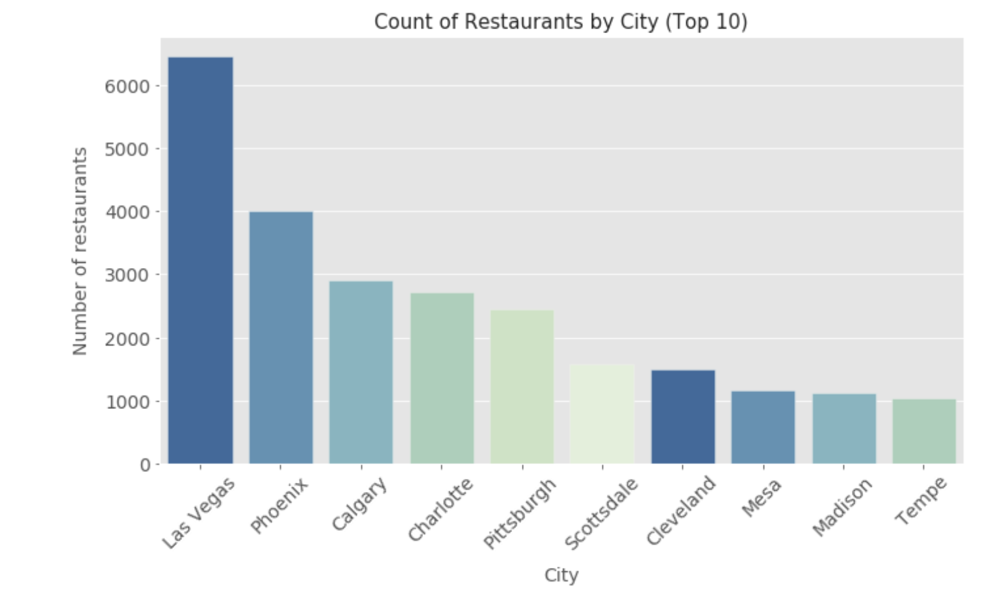
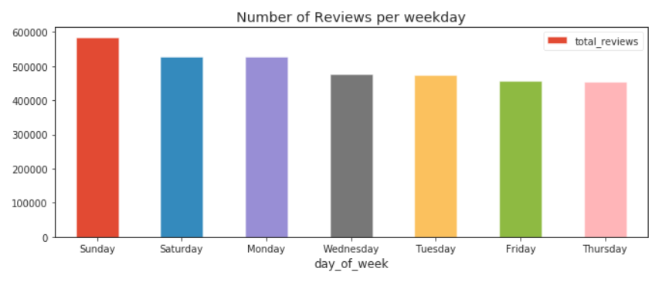
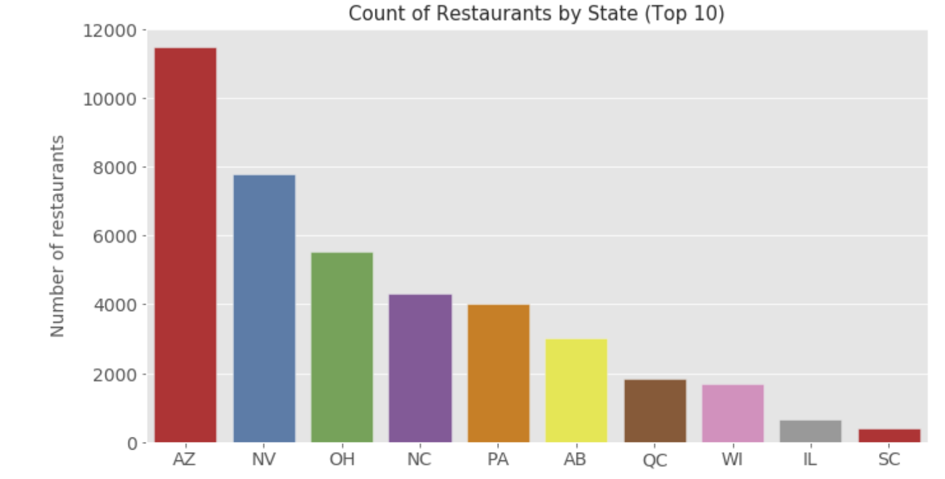
Data – Exploratory Analysis
11840 open restaurants
Sunday is the day of the week with more reviews
Arizona state has more restaurants and Las Vegas is the city with more restaurants

Slide 5
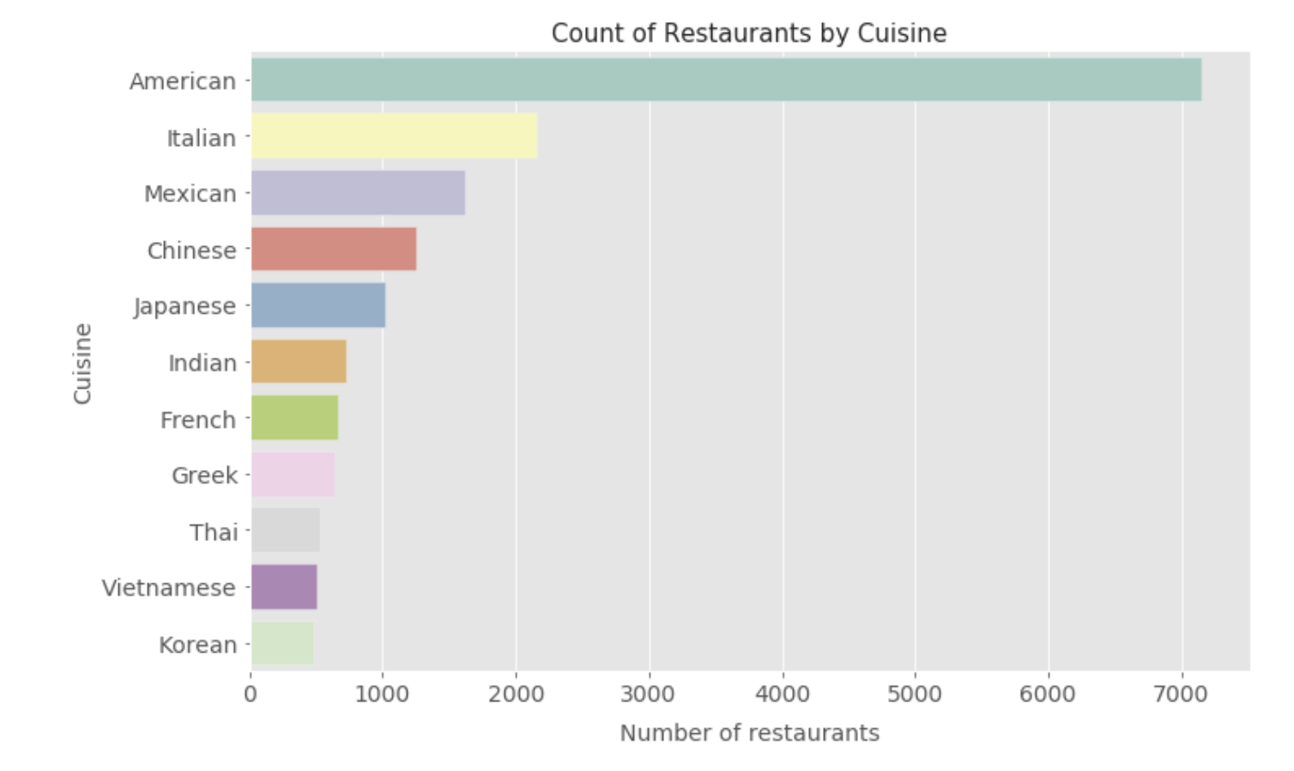
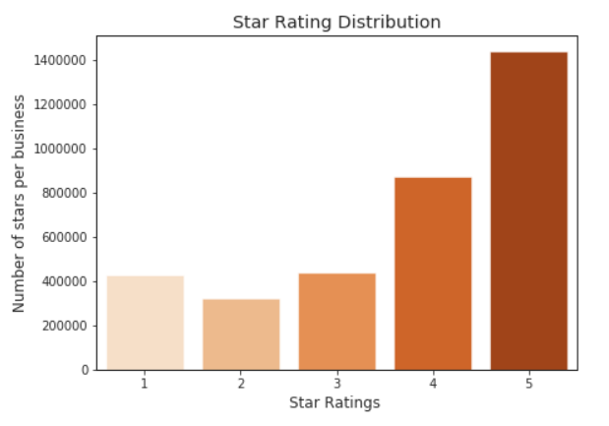
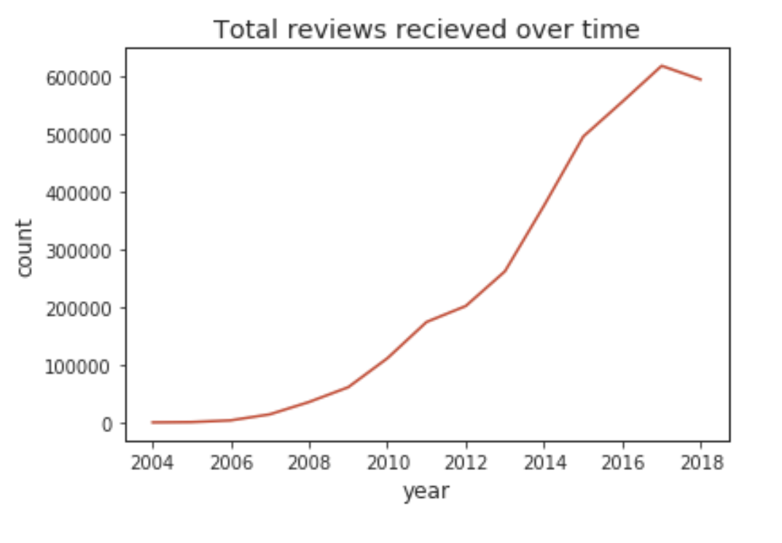
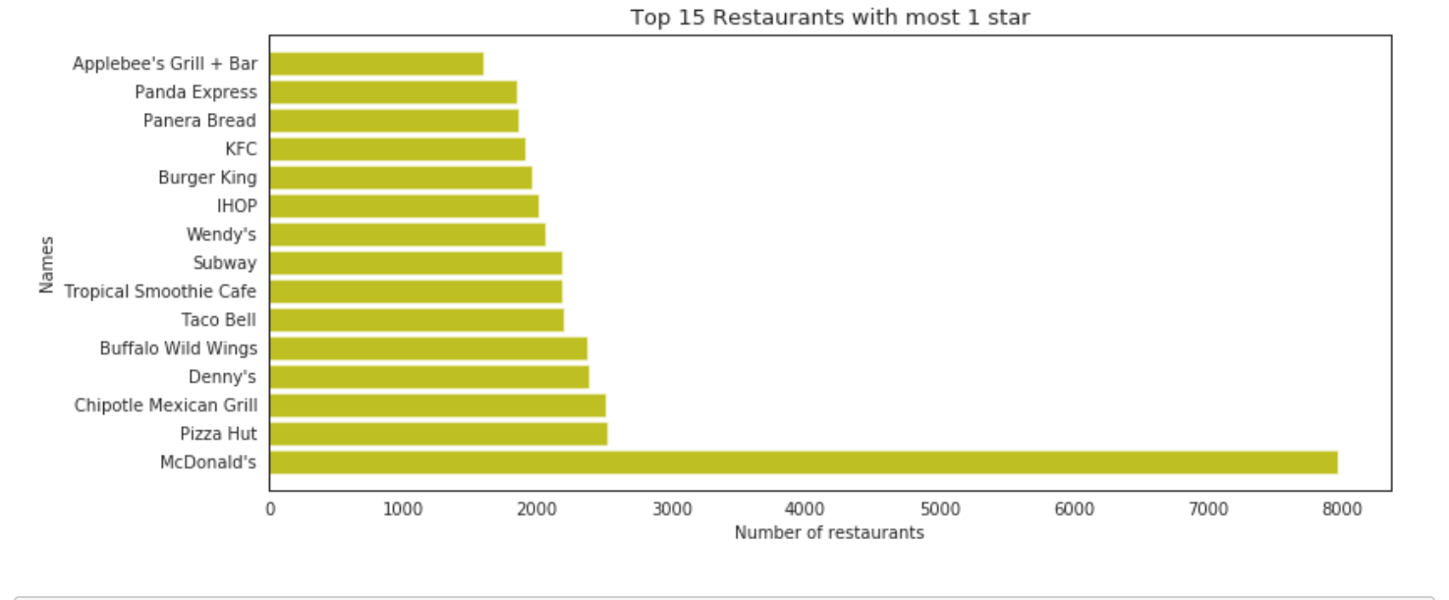
Data – Exploratory Analysis
People tend to rate restaurants if they like them a lot or if they want to share dissatisfaction
McDonald’s is the least appreciated restaurant in terms of stars
Most restaurants in the dataset are American cuisine followed by Italian and Mexican food

Slide 6
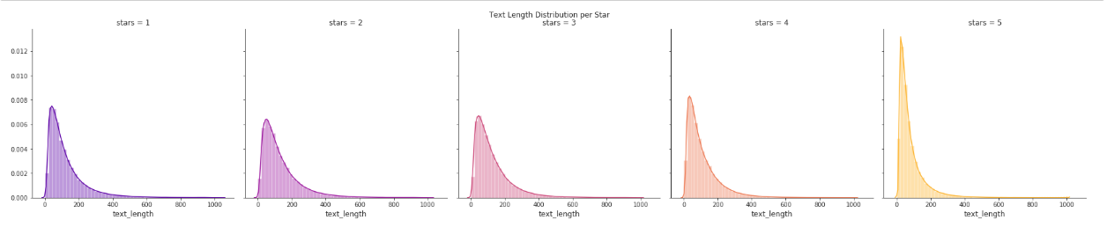
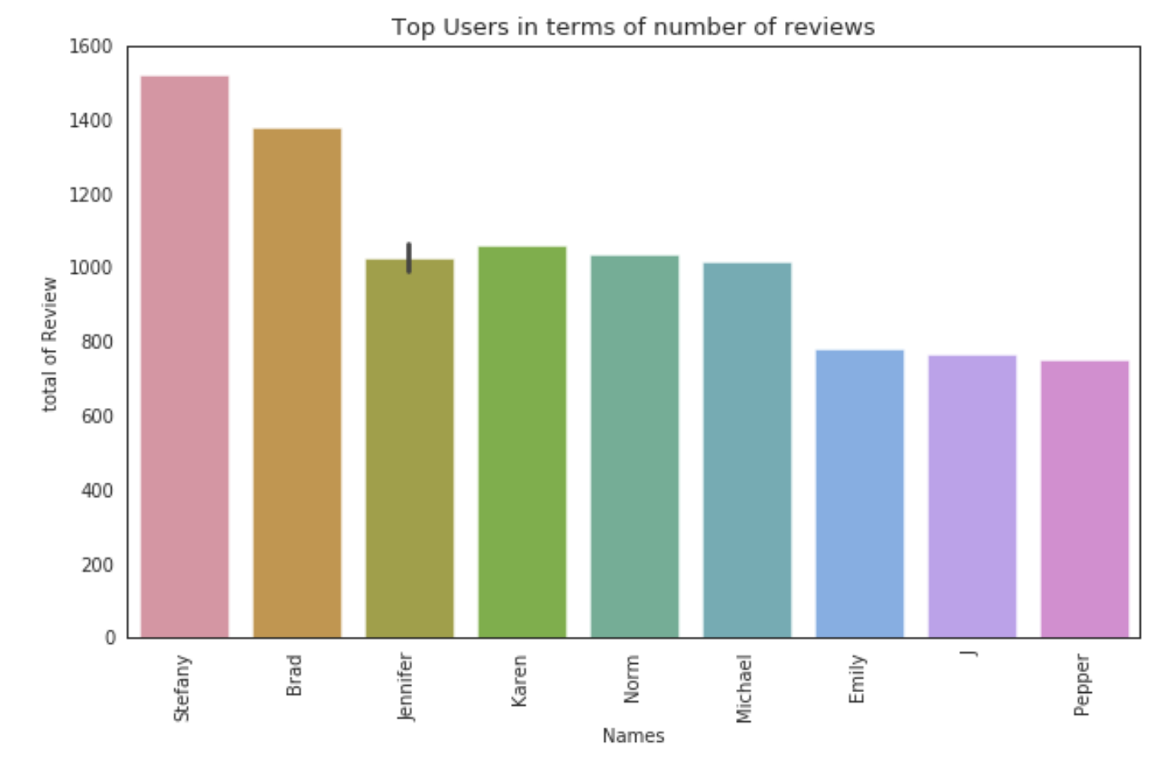
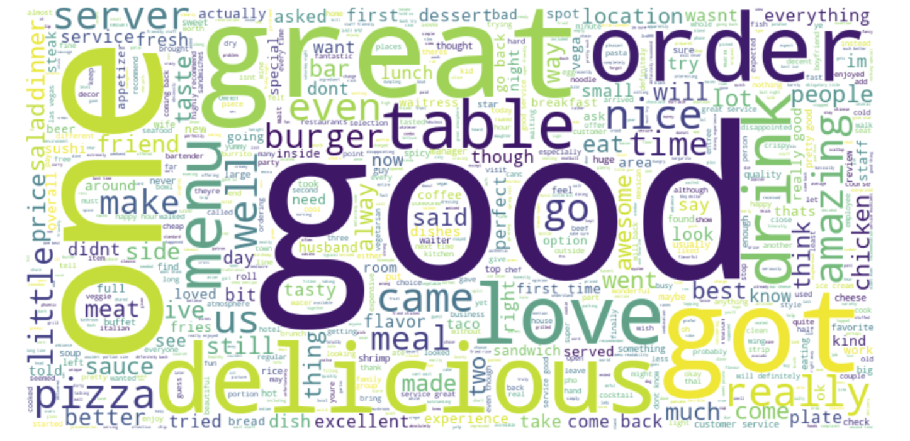
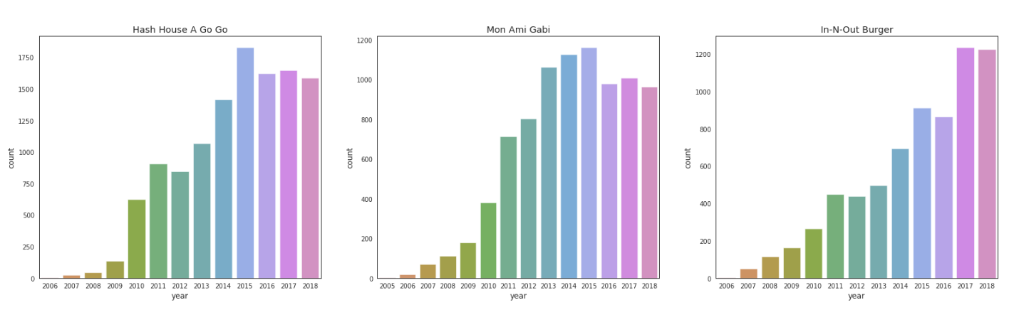
Data – Exploratory Analysis
Restaurants with 5*s tend to get shorter reviews compare to other *s
Stefany has posted the largest number of reviews
Top 3 restaurants in terms of reviews received over time

Slide 7

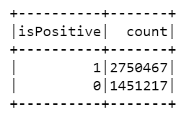
Data – Sentimental Analysis
1
Cleaning steps:
Change everything to lower case
Remove punctuation
Stop words
Tokenize sentences into words
2
Defining values:
Y value: > = 4 stars - Positive review (1)
Y value: < 4 stars - Negative review (0)
65% of the reviews’ restaurants received are positive
HashingTF
VS CountVectorizer
HashingTF is a transformer that takes sets of terms (bag of words) and converts those sets into fixed-length feature vectors. A raw feature is mapped into an index (term) by applying a hash function. HashingTF is irreversible, meaning we can’t restore original input from a hash vector. This requires only a single scan and no additional memory.
CountVectorizer provides a simple way to both tokenize a collection of text documents and build a vocabulary of known words, but also encode new documents using that vocabulary. CountVectorizer with model (index) can be used to restore unordered input, meaning models can be harder to interpret. This requires additional scan over the data to build a model and additional memory to store vocabulary (index).

Slide 8
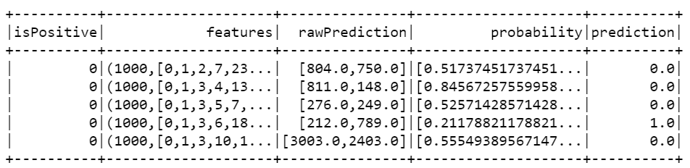
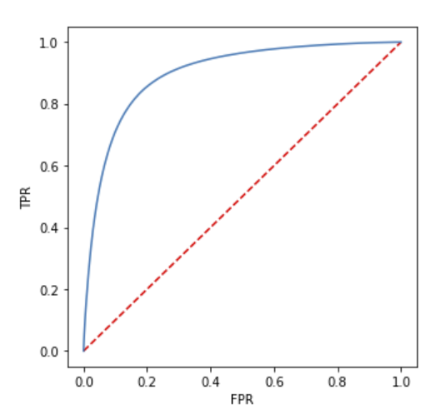
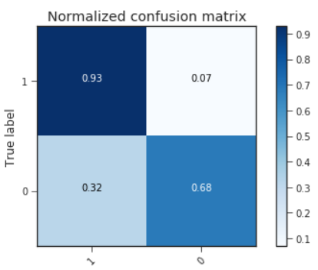
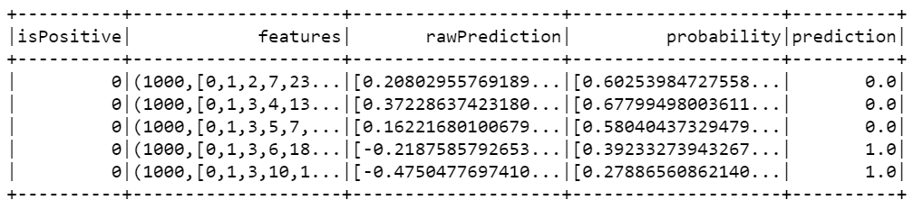
Data – Sentimental Analysis
HashingTF
Decision Tree Classification
Accuracy: 73.5% | F1 score: 73.8%
Accuracy: 83.9% | F1 score: 83.4%
Logistic Regression Classification
Accuracy: 84.6% | F1 score: 84.2%
Gradient Boost Classifier
Accuracy: 76.5% | F1 score: 75.1%

Slide 9
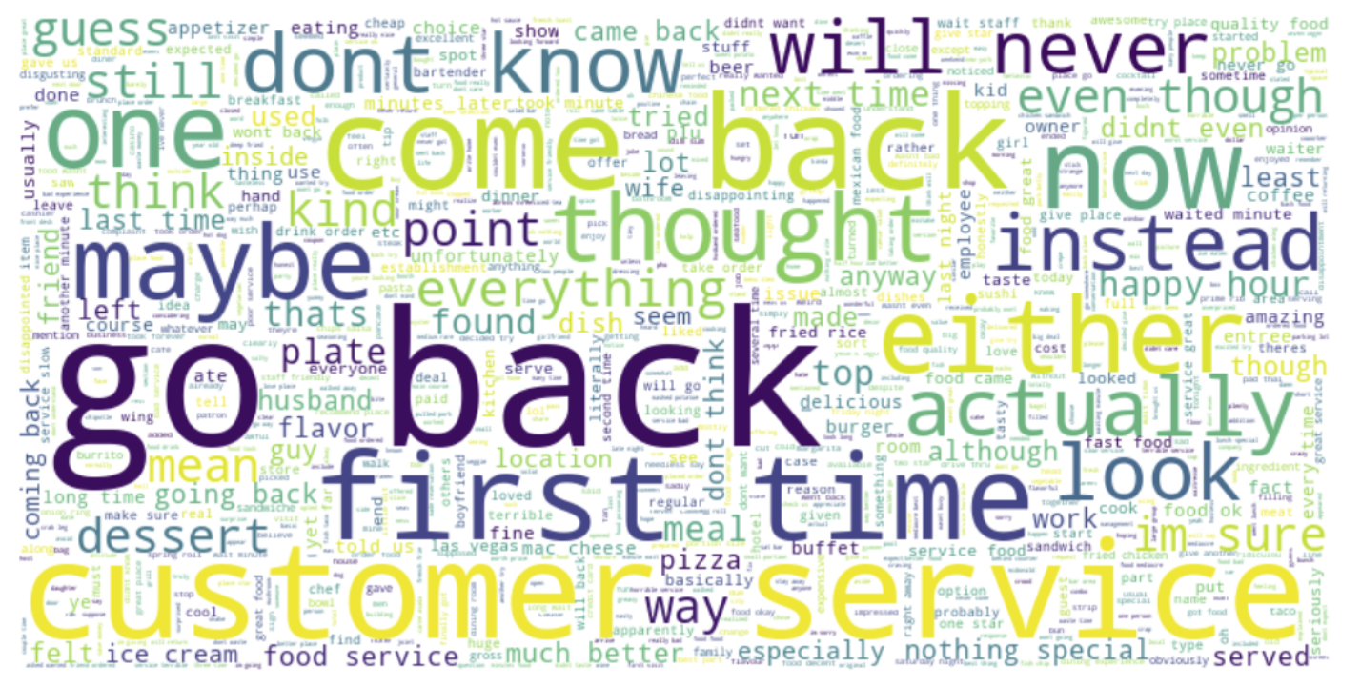
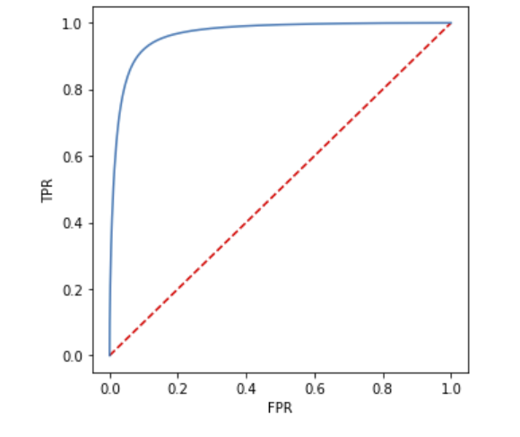
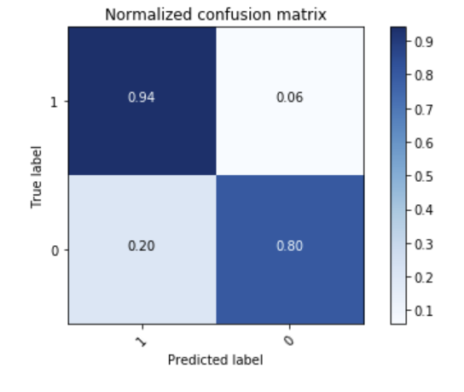
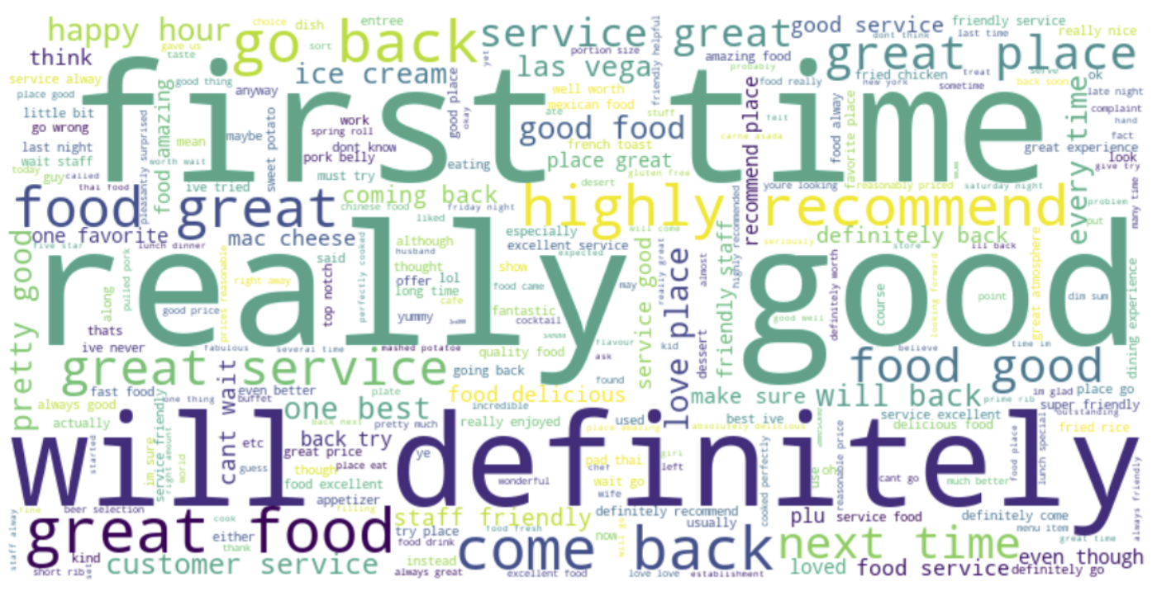
Data – Sentimental Analysis
CountVectorizer
Accuracy: 89.3% | F1 score: 89.2%
Positive
Logistic Regression Classification
Accuracy: 89.3% | F1 score: 89.2%
Negative

Slide 10


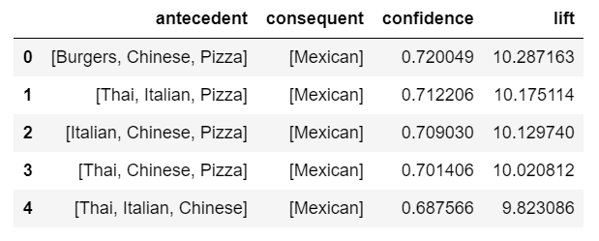
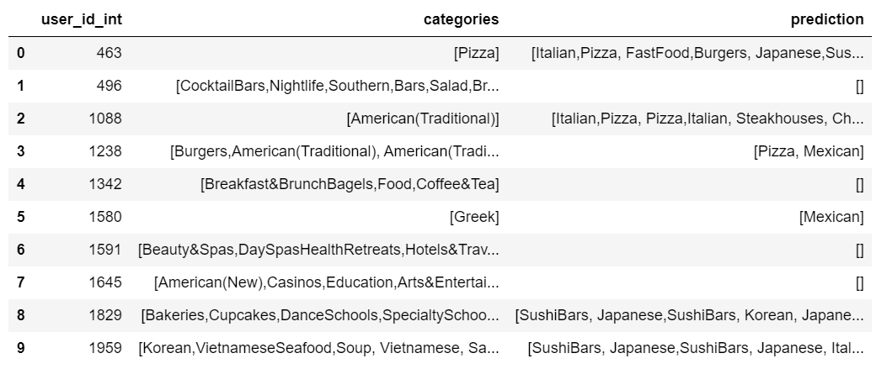
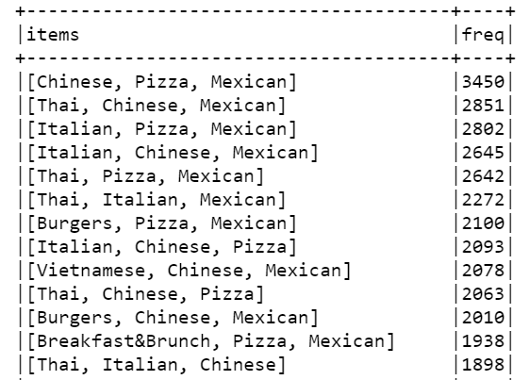
Association Mining
Association Rules
Frequent Items
Predictions

Slide 11
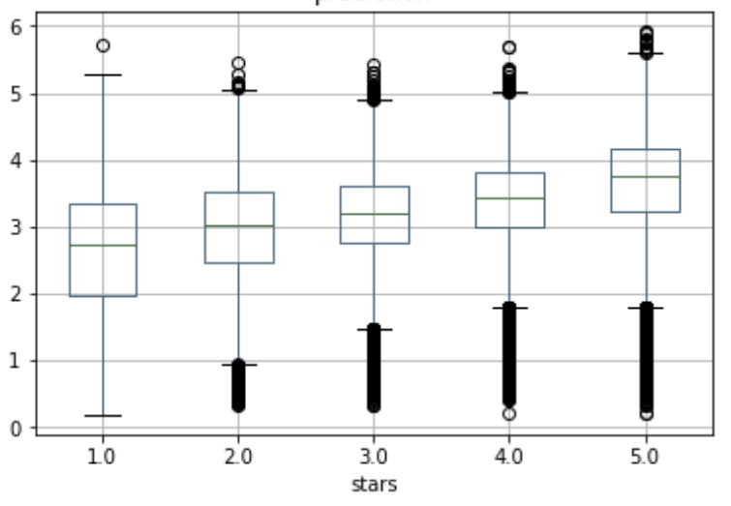

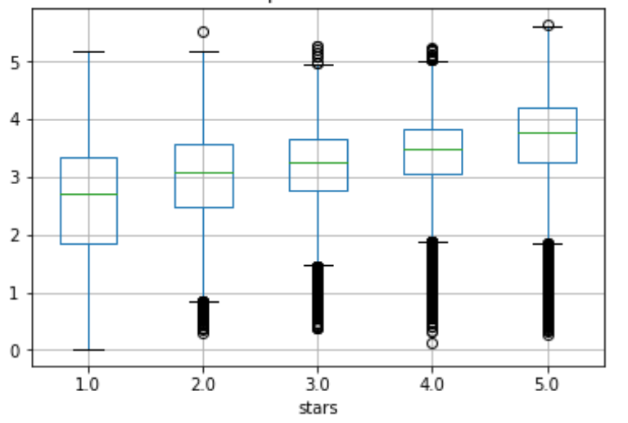
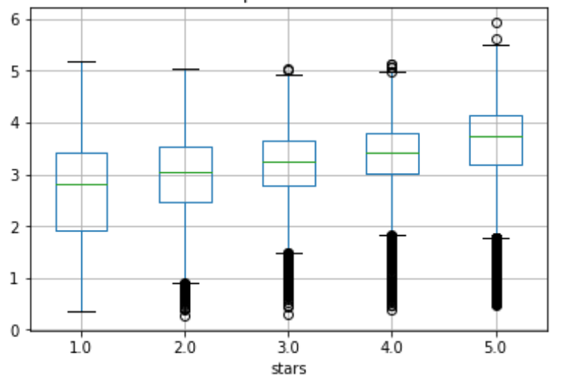
Las Vegas
Alternative Least Squares
RMSE: 1.374 | r2: -0.097
ALS is an iterative optimization process where we for every iteration try to arrive closer to a factorized representation of the original data. The algorithm is based on “Collaborative Filtering for Implicit Feedback Datasets”.
Phoenix
RMSE: 1.366 | r2: -0.102
Scottsdale
RMSE: 1.392 | r2: -0.180

Slide 12
Alternative Least Squares
Recommendation for Restaurants and Users
Albinas Italian American Bakery
Allan
BBQ Concepts
Fernandez Hot-Dogs
The Steakhouse at Treasures
Tacos LV
Southern Kitchen
Pretzel Time
Potato Valley Café
Pho Ha Noi
China Gourmet
Winter In July
Paul
Kastle
Cynthia
Shanna
Brooke
Patrick
Johan
Aimee
Paul
Danyelle

Slide 13
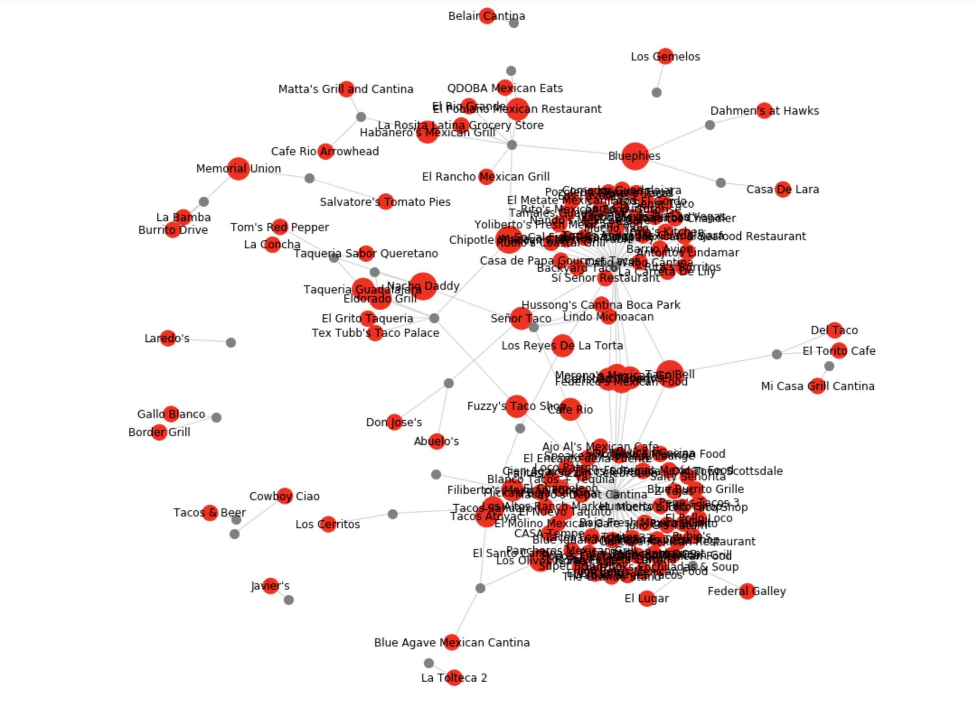

Graphs
Here we can filter on a restaurant category and stars review
This allows the user to have a visual representation of popular restaurants among your friends
Each node represents a friend (grey) of a user and a restaurant (red)
The larger the red nodes the more reviews from friends
This graphic shows 4 and 5*s ratings from Mexican restaurants for one user who has ~200 friends

Slide 14


Work Limitations &
Future Work
Resources limitations - RCC and Google Cloud (we end had to limit the amount of data to be able to run the models)
Package limitations with RCC
Visualization limitations with PySpark
Further cleaning restaurant categories and better cluster them
Use Geolocation to give more precise recommendations
Expand the recommendation to other cities
Use Page Rank to rank users to give more weight to their reviews

Slide 15

Thank You
#enjoy vacation with Yelp

